Slide 1


Descriptive Statistics: Measures of Dependence
Notes:
In this presentation we will describe various measures of dependence and discuss their implementation in R

Slide 2
Measures of Dependence
Correlation is a statistical technique used to determine the degree to which two variables are related
Correlations are useful because they can indicate a predictive relationship that can be exploited in practice.
Two types of correlation statistics are discussed in this course:
Pearson Correlation Coefficient
Spearman Rank Correlation Coefficient
Notes:
In statistics, dependence or association is any statistical relationship between two random variables. However, most often correlation refers to how close two variables are to having a linear relationship with each other. Familiar examples of dependent phenomena include the correlation between the demand for a limited supply product and its price.
Correlations are useful because they can indicate a predictive relationship that can be exploited in practice. For example, an electrical utility may produce less power on a mild day based on the correlation between electricity demand and weather.
In this presentation, we consider two types of correlation statistics: Pearson Correlation Coefficient and Spearman Rank Correlation Coefficient.

Slide 3
Pearson Correlation Coefficient
The Pearson correlation coefficient is a scale free measure of the linear correlation between two variables X and Y.
It has a value between +1 and −1, where 1 is total positive linear correlation, 0 is no linear correlation, and −1 is total negative linear correlation.
The correlation coefficient is symmetrical with respect to X and Y.
The correlation coefficient is independent of the choice of origin and scale of measurement of the variables
Notes:
Pearson’s correlation coefficient is the statistics that measures the statistical relationship, or association, between two continuous variables. It is known as the most common method of measuring the association between variables of interest.
Pearson’s correlation coefficient varies between -1 to 1 and therefore gives information about the magnitude of the association, or correlation, as well as the direction of the relationship. The correlation coefficient is symmetrical with respect to X and Y which means that correlation of X and Y is equal to the correlation of Y and X.
It is also a scale and origin free statistics. Scale free means that multiplying the variables by a constant does not change the value of the correlation. Origin free means that adding or subtracting a constant value to or from the variables does not affect the correlation coefficient.

Slide 4
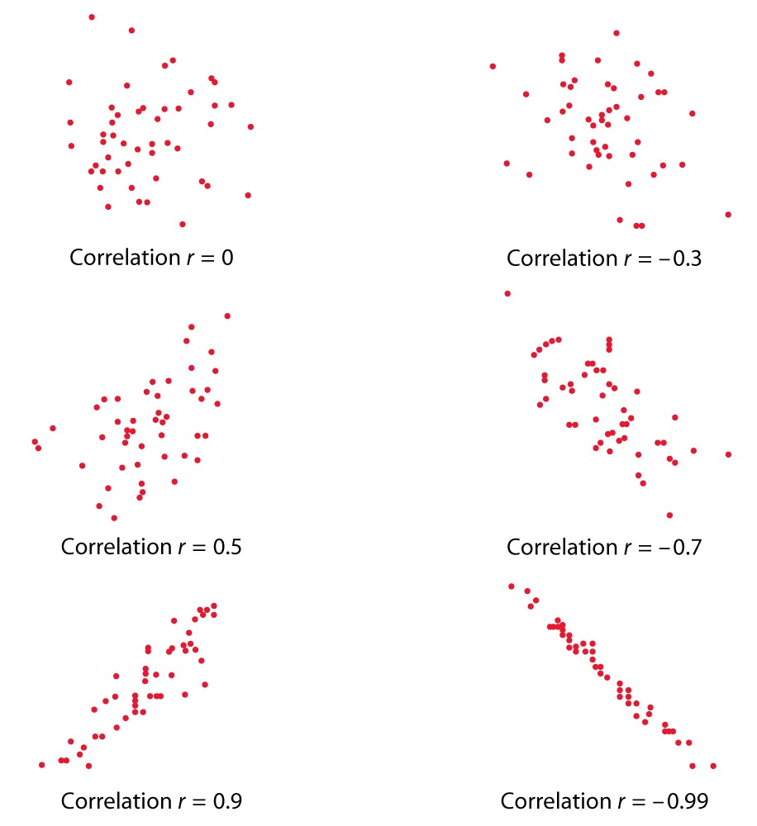
Pearson Correlation Coefficient
Notes:
Here are a few visual examples of the Pearson Correlation Coefficient. In the top row on the left hand side we can see that there is not really a clear relationship between the values on the x and y axis. Therefore the correlation value is equal to 0. On the right hand side, however, you can see that there is a mild negative correlation between the values of x and y and, therefore, the correlation value is - 0.3. The correlation values are stronger in the second row; a positive correlation is shown on the left hand side but the correlation value is equal to 0.5 and a stronger negative correlation is shown on the right hand side. The third row shows very strong correlations. On the left hand side you have a very strong positive correlation. There the correlation coefficient is 0.9, and a very strong negative correlation of - 0.99 is shown on the right side.

Slide 5
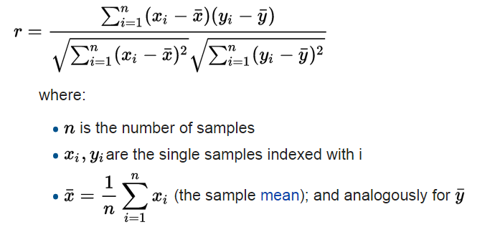
Pearson Correlation Coefficient
If we have one dataset {x1,...,xn} containing n values and another dataset {y1,...,yn} containing n values then the Pearson correlation coefficient can be computed as
Notes:
This is how the Pearson correlation coefficient is calculated. According to the formula, for two variables x and y each containing n data points, the Pearson correlation coefficient is calculated as the average cross-product of the standardized version of the two variables. In this formulation xi represents the element i of the vector X and x bar represents the mean of X. Similar notations are used for the Y variable.

Slide 6
Spearman Rank Correlation Coefficient
The Spearman correlation between two variables is equal to the Pearson correlation between the rank values of those two variables; while Pearson's correlation assesses linear relationships, Spearman's correlation assesses monotonic relationships (whether linear or not).
Spearman Rank can be applied to both ordinal (they are already ranked) and numerical (i.e. interval) variables. With numerical variables, we need to first sort them and use their ranking instead.
Like Pearson correlation, the Spearman correlation is symmetric.
Notes:
The Spearman correlation between two variables is equal to the Pearson correlation between the rank values of those two variables; while Pearson's correlation assesses linear relationships, Spearman's correlation assesses monotonic relationships (whether linear or not).
Intuitively, the Spearman correlation between two variables will be high when observations have a similar rank between the two variables. A perfect Spearman correlation of +1 or −1 occurs when each of the variables is a perfect monotone function of the other.
Spearman Rank can be applied to both ordinal (they are already ranked) and numerical (i.e. interval) variables. With numerical variables, we need to first sort them and use their ranking instead.
Like Pearson correlation, the Spearman correlation is symmetric.

Slide 7
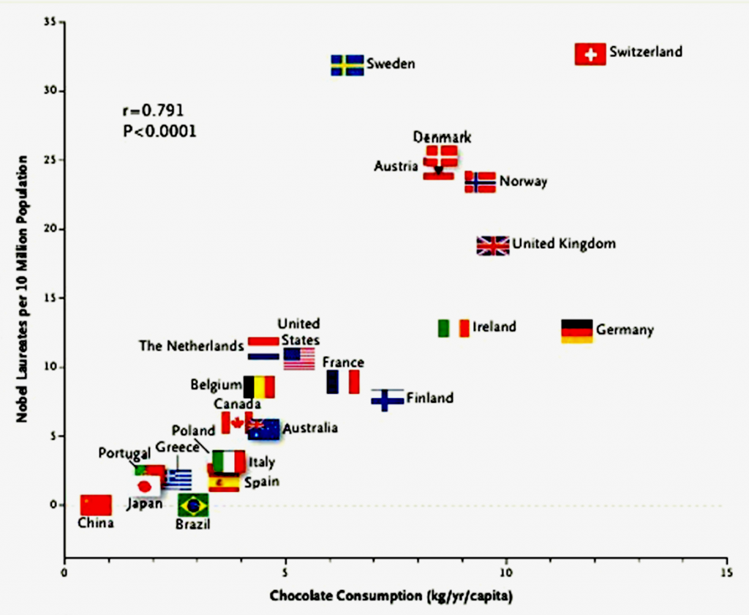
Correlation Does not Imply Causation
There seems to be a high correlation between chocolate consumption and the number of Nobel prizes won by different countries? Can consuming chocolate make people smart? !
Notes:
Correlation and causation are terms which are mostly misunderstood and often used interchangeably. Correlation is a statistical technique which tells us how strongly the pairs of variables are linearly related and change together. It does not tell us why and how behind the relationship but it just says the relationship exists. Causation takes a step further than correlation. It says any change in the value of one variable will cause a change in the value of another variable, which means one variable makes other to happen. It is also referred to as cause and effect.As a result, in many cases, the correlation may not imply the causation. An example is given here where there seems to be a high correlation between chocolate consumption and the number of Nobel prizes won by different countries. Should this lead us to believe that consuming chocolate makes people smarter? As you might have guessed, the answer is ‘no’. In this example, the consumption of chocolate as a luxury product is higher in richer countries which are likely to spend more budget on research and education as well. So remember next time that you found a correlation between the variables, take time to find other underlying factors that might be the cause as correlation is just the first step.

Slide 8
Implementation in R
# We will use a dataset called Wage that is in the 'ISLR' package #install.packages('ISLR') #install the package # Call the library library(ISLR)
## Warning: package 'ISLR' was built under R version 3.4.4
#Check the name of the columns colnames(Wage)
## [1] "year" "age" "maritl" "race" "education" ## [6] "region" "jobclass" "health" "health_ins" "logwage" ## [11] "wage"
# plot the wage against age plot(Wage$age, Wage$wage)
Notes:
Let us consider an example in R. for this example we will use a dataset called “wage” that is included in the ISLR package. For using the package, you need to install the package first. The command for installing the package is install.packages and then you need to provide the name of the package. Once the package is installed, you need to call the library to make sure the methods and datasets are available. For that, we use the function “library” and the name of the package, which in this case is ISLR. So lets look at the columns included in the wage data frame. For that we can use the “colnames” function. In this case, as you can see the data frame contains variables such as year age, marital status, race, education, region, job class, health, health insurance, log wage, and wage. So let’s start by plotting the wage against the age; the function for plotting is “plot” and we need to provide two variables, which one would be the x-axis and one would be the y-axis. So if you want to plot wage against age you can write “plot(wage$age)” and the second input would be “wage” which is “wage$wage.”

Slide 9
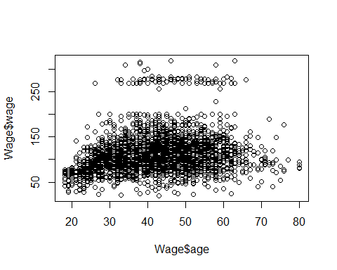
Implementation in R
Notes:
Here is the graph of the wage against the age. As you can see, it is very difficult to detect any strong correlation between the data points. However, the wage is shown to be slightly correlated with age, especially when the age values are small. So you can see the increase in the wage when the age values increases from 20 to 30.

Slide 10
Implementation in R
# Calculate the Pearson correlation between the age and wage cor(Wage$age,Wage$wage,method='pearson')
## [1] 0.1956372
# The default method is Pearson so you can skip defining it explicitly cor(Wage$age,Wage$wage)
## [1] 0.1956372
# Correlation is symmetric and scale free cor(Wage$wage,Wage$age)
## [1] 0.1956372
cor(Wage$wage+10,(Wage$age/7)-4)
## [1] 0.1956372
Notes:
Let us continue and calculate the Pearson Correlation between the age and wage. The function for calculation of the correlation is “cor” and we can identify the method as Pearson. So the correlation value in here is 0.19, which as we expected is positive but is not extremely strong. You should also note that the default method for the correlation function is Pearson, so even if you don’t explicitly identify the method as Pearson, the Pearson correlation coefficient is calculated, which is shown in here as well. Also, we can show that the correlation is symmetric, so if you calculate the correlation between the age and wage, the correlation is exactly the same if you swapped the order of the variables. Also, we know that the correlation is scale free and also origin free. So in this case, if we add a particular constant value to one of the variables or divide the other variable by a given number, or multiply that variable by a given number, and subtract another constant from the variable, the correlation is expected to be the same. And this is true in here; so we can see that the correlation of Wage$wage+10, and Wage$age divided by 7 minus 4 is exactly the same as the correlation of wage$wage and wage$age.

Slide 11
Implementation in R
cor(Wage$education,Wage$wage)
Error in cor(Wage$education, Wage$wage) : 'x' must be numeric
# Show the levels of the education levels(Wage$education)
## [1] "1. < HS Grad" "2. HS Grad" "3. Some College" ## [4] "4. College Grad" "5. Advanced Degree"
min(Wage$education)
Error in Summary.factor(c(1L, 4L, 3L,: ‘min’ not meaningful for factors
# Convert education to an ordered factor Wage$education_ordered=ordered(Wage$education,levels = c("1. < HS Grad","2. HS Grad", "3. Some College","4. College Grad","5. Advanced Degree"))
Notes:
How about if we wanted to examine the correlation between the education level and wage. If we type the function correlation wage$education and wage$wage, we would see that there would be an error message complaining that the variables are not numeric. So here we know that the education variable is a categorical variable, so we can show the levels of education by using the commands level. In here we can see 5 levels, less than high school graduate, high school graduates, some college, college graduates, and advanced degree. Let’s see if this categorical variable is ordered. If the categorical value is ordered, we can basically find the minimum and maximum value. So if we type minimum of wage$education, we will see than an error message is being shown, and this is because by default, the categorical variables unordered in R. so one thing that we need to do first is to convert the education into ordered factors. The command for that is “ordered.” So we can use the order function and we can explicitly define the order of the levels as well. So we define a new variable called “education$order” and we say education$order is equal to order wage$education and then we define the orders of the levels as we want.

Slide 12
Implementation in R
min(Wage$education_ordered)
## [1] 1. < HS Grad ## 5 Levels: 1. < HS Grad < 2. HS Grad < ... < 5. Advanced Degree
cor(as.numeric(Wage$education_ordered),Wage$wage, method='spearman')
## [1] 0.5031817
Notes:
After we converted the education variable into an ordered factor, we can use the mean function to see the first level. In here the first level is shown as less than high school graduates, and the other four levels are printed out for us as well. Now that the variable has been converted to order, we can use the as numeric function to convert it to the numerical and use the spearman rank correlation to calculate the correlation between the education and wage. By doing so, we can see that the correlation value is shown as 0.50, which is pretty strong. This is expected because the wage is highly correlated to the education level of individuals.

Slide 13
Implementation in R
# A simple example to show the difference between Pearson and Spearman Correlation A=c(1,2,3,4,5); B=c(11,10,14,15,17); C=c(11,10,14,15,1000); print(paste('Spearman Correlation between A & B is ', cor(A,B,method = 'spearman')))
## [1] "Spearman Correlation between A & B is 0.9"
#The Spearman Correlation doesn't change as long as the rank orders are the same print(paste('Spearman Correlation between A & C is ', cor(A,B,method = 'spearman')))
## [1] "Spearman Correlation between A & C is 0.9"
Notes:
So here is a simple example that shows the difference between the Pearson and Spearman correlation. For this example, consider three variables, variable “A” which contains values of 1,2,3,4, and 5, “B” which contains values of 11,10,14,15,17, and variable “C” which contains values of 11,10,14,15, and 1000. Let us start by calculating the Spearman correlation between “A” and “B.” in this case the Spearman correlation would be 0.9. As we can see, the Spearman correlation is exactly the same when calculating the correlation between “A” and “B” and between “A” and “C.” the reason for that is because the rank order of the numbers in both “B” and “C” vectors are exactly the same. The difference is that in vector “C” we have 1000 instead of 17. But because the order is exactly the same, 17 is the largest number in vector “B” and 1000 is the largest number in vector “C” the Spearman rank correlation doesn’t change in these 2 cases.

Slide 14
Implementation in R
#... but Pearson Correlation does! print(paste('Pearson Correlation between A & B is ', cor(A,B,method = 'pearson')))
## [1] "Pearson Correlation between A & B is 0.932996209912368"
print(paste('Pearson Correlation between A & C is ', cor(A,C,method = 'pearson')))
## [1] "Pearson Correlation between A & C is 0.709963275688815"
Notes:
Now let’s examine the Pearson correlation. Of course the Pearson correlation is expected to be different for “A” and “B” and “A” and “C” because Pearson correlation is calculated based on the actual values and not the ranking. And as we can see the correlation between “A” and “B” is close to 0.93, where as the correlation between “A” and “C” is 0.70 because there is less linearity in here due to the large number that has been added to the end of variable “C.”

Slide 15
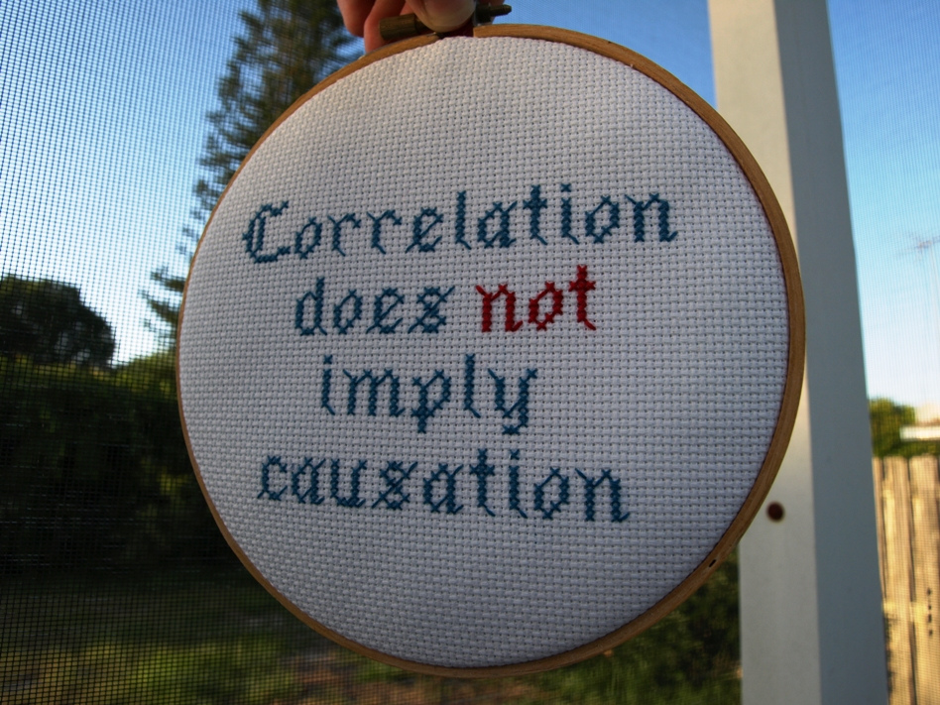
Remember This!
Notes:
https://flic.kr/p/86y2u1

